Slide 1

Navigating Creative Commons: Empowering Knowledge and Sharing
Brenda Smith, Open Education Librarian | October 2024
“Navigating Creative Commons: Empowering Knowledge and Sharing” by Brenda Smith is licensed under CC BY-SA 4.0, except where otherwise noted.

Slide 2
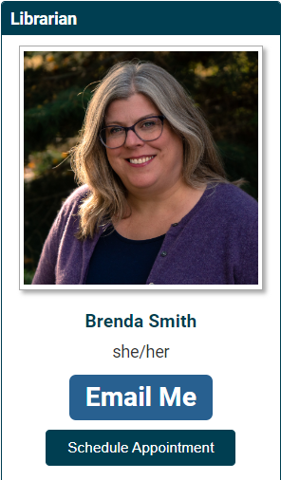
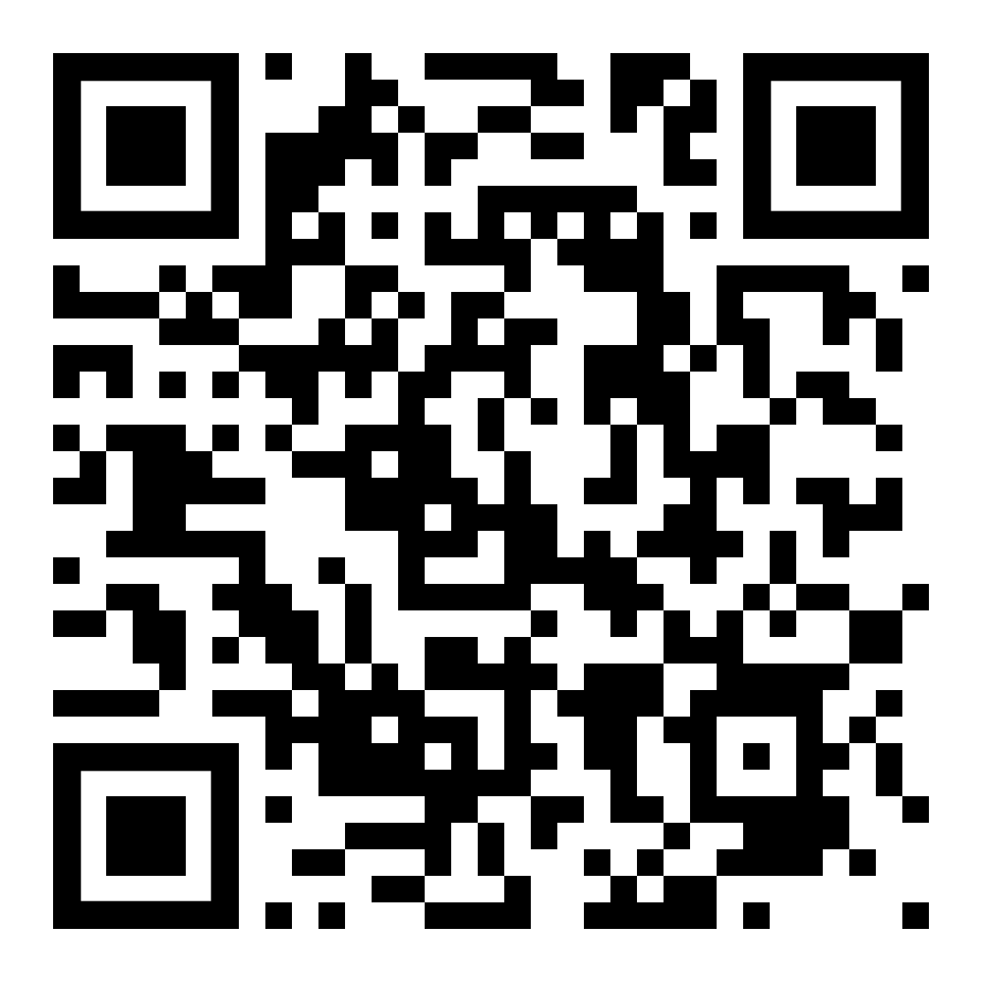
Hello / Weyt-k!
Master of Arts in History (Simon Fraser University)
Master of Library and Information Studies (University of British Columbia)
I am the librarian for…
Arts/Education/Business Liaison Team (Lead)
Environment, Culture & Society department
Philosophy, History & Politics department
Psychology department
MA Human Rights & Social Justice program
Open Education
Interlibrary Loans (Coordinator)

Slide 3
Land Acknowledgement
Thompson Rivers University campuses are on the traditional lands of the Tk'emlúps te Secwépemc (Kamloops campus) and the T’exelc (Williams Lake campus) within Secwépemc'ulucw, the traditional and unceded territory of the Secwépemc. Our region also extends into the territories of the Stl'atl'imx, Nlaka’pamux, Nuxálk, Tŝilhqot'in, Dakelh, and Syilx peoples
Notes:
Acknowledge that we are here today on the unceded territories of the Tk’emlups te Secwepemc ne Secwepemcúl’ecw, a place where learning has taken place since time immemorial. I come from an English, Scottish, and Icelandic background, and grew up in the Vancouver area on the lands of the Tsawwassen and Musqueam Peoples​. I came to Kamloops over 20 years ago for a tenure track faculty job here at TRU. As a guest on this land, I would like to thank the generosity of our Tk’emlups te Secwepemc hosts.

Slide 4

Today’s Learning Outcomes
Explain the basic principles of copyright law and context that led to Creative Commons
Differentiate and apply Creative Common licences
Find, use and attribute Creative Commons licensed works
Advocate for open licensing and OER
"Learning Outcomes" by EducIcons, Wikimedia Commons is licensed under CC BY-SA 4.0

Slide 5

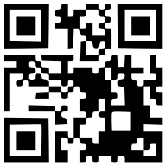
Question 1
You're an instructor at TRU and you're writing a chapter on teaching practices in your discipline. You're hoping to include an example worksheet created by a colleague. Can you publish the worksheet as part of your chapter?
www.menti.com
Code: xxxx xxxx
"Question Mark Icon" by isaiah658 is in the Public Domain, CC0
Notes:
Note: When presenting, I’d put in a real QR code that links to a live mentimeter question.

Slide 6
Copyright Basics

Slide 7

A Little Bit about Copyright
Copyright grants copyright holders exclusive rights, preventing others from copying, distributing, publicly performing, adapting, or using the work in any way beyond viewing or reading without permission.
"Copyright Symbols" by Mike Seyfang is licensed under CC BY 2.0

Slide 8
What does copyright cover?
Copyright protects the expression of facts or ideas, not the facts or ideas themselves
literary works (e.g., books, computer programs, software, and other works consisting of text)
dramatic works (e.g., movies, plays, screenplays, and scripts)
musical works (e.g., musical compositions with or without words)
artistic works (e.g., paintings, drawings, maps, photographs, sculptures, and plans)

Slide 9
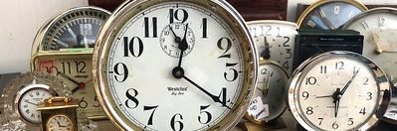
When does it start?
Copyright protection is automatic the moment a work is created in a material form
"2020/366/365 Time Enough, Will it Last?" by Alan Levine is in the Public Domain, CC0
Notes:
Copyright protection is automatic the moment a work is created in a material form. While not required, registering with the Canadian Intellectual Property Office (CIPO) provides legal benefits and a public record.

Slide 10

How long does it last?
In Canada, copyright expires 70 years after the death of the creator
Then, the work joins the public domain
Notes:
life of the creator +70 years ➔ public domain
Before Dec. 22, 2022, it was 50 years
This change was not retroactive; it does not revive copyrights that expired before January 1, 2023
This means if the author died in 1971 or before, it’s public domain. But no further works will enter the public domain in Canada until 2043.

Slide 11
Public Domain
No permission is needed to copy, use, adapt, or share!
Applies to works that are not subject to copyright because:
the copyright expired
it was never entitled to copyright
creator put it into the public domain
holder failed to maintain copyright
Notes:
Applies to works that are not subject to copyright because:
the copyright expired (remember that is now 70 years after death of creator, unless they died in 1971 or before)
it was never entitled to copyright (e.g., ideas/facts)
creator intentionally and explicitly dedicate it into the public domain (e.g., US federal publications – not Canadian because Canadian federal and provincial government works are protected by Crown copyright)
holder failed to maintain copyright

Slide 12

Creator vs. Copyright Owner
Creators and copyright owners may not be the same
Note: See TRU/TRUFA Collective Agreement Article 9.4 for details
TRUFA work
vs.
Open Learning work
Notes:
At TRU, TRUFA members maintain copyright for any work product, including creative work, instructional strategies or curriculum/instructional material, software or any other material or technology that may be copyrighted or patented
Unless you are hired or agree to create and produce copyrightable work product for the university or are paid in addition to regular rate of pay for time to produce product. This all means that whatever you create for Open Learning courses, you do not retain copyright unless you negotiate it.

Slide 13
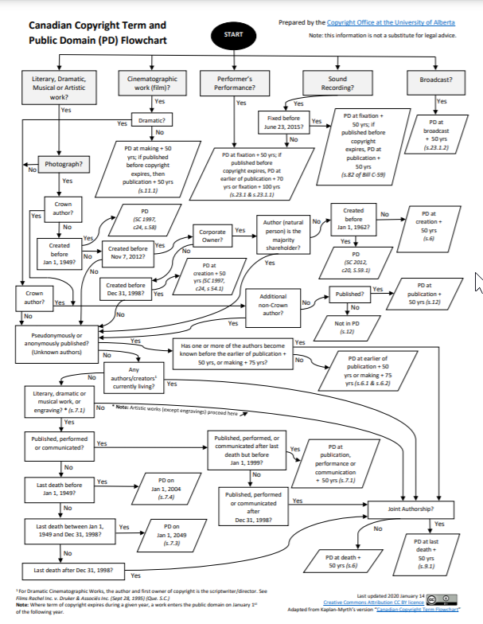
BUT …
Copyright law is difficult to navigate
Non-experts may find it challenging to interpret and apply to everyday use
Can stifle (creative) use of copyright-protected content
Fair dealing exceptions can be confusing
"Canadian Copyright Term and Public Domain (PD) Flowchart" by Copyright Office, University of Alberta is licensed under CC BY 4.0 / A derivative from the original work
Notes:
If you detailed questions about copyright, contact TRU’s Intellectual Property Office

Slide 14
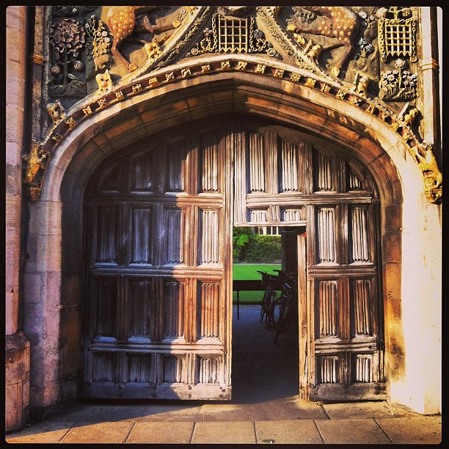
Enter Open Licensing
Open licences allow creators to waive some rights and keep others
More permissive than traditional “all rights reserved” copyright model
"Open door policy" by Ken Banks is licensed under CC BY 2.0
Notes:
In the 1990s, with the rise and spread of the Internet and other technology, tension arose between technological capabilities and what existing copyright laws allowed.
Open licences were a response to this outdated copyright system.
An Open licence is a document that specifies what can and cannot be done with a work (whether sound, text, image, or multimedia). It grants permissions and states restrictions. The specific permissions granted depend on the type of open licence the creator chooses.
Open licences enable collaboration, development, access, and inspiration from your creative works without requiring you to give up the rights (copyright) automatically granted to you for your creation.
In other words, An open licence lets you retain ownership of your work, while allowing others to use, share, and remix it, without requesting your permission. For most open licences, the minimum that is required of the users is to attribute you (aka give credit) for your work.

Slide 15
Benefits of Open Licences
Creators
increased visibility
collaboration opportunities
Educators
access to resources
customization
Public
free access
lifelong learning
Notes:
Many benefits of open licences
For Creators
Increased Visibility: Open licenses allow creators to share their work widely, reaching a larger audience and gaining more recognition.
Collaboration Opportunities: By allowing others to use and adapt their work, creators can foster collaborations and innovations.
For Educators
Access to Resources: Educators can freely use and adapt a wide range of materials, enhancing their teaching without legal or financial barriers.
Customization: Open licenses enable educators to tailor resources to fit their specific teaching needs and contexts.
For the Public
Free Access: Openly licensed materials are often available at no cost, making knowledge and creative works accessible to everyone.
Lifelong Learning: The public can use these resources for personal growth, education, and cultural enrichment without restrictions
These benefits collectively promote a culture of sharing and innovation, supporting educational and creative advancements.

Slide 16
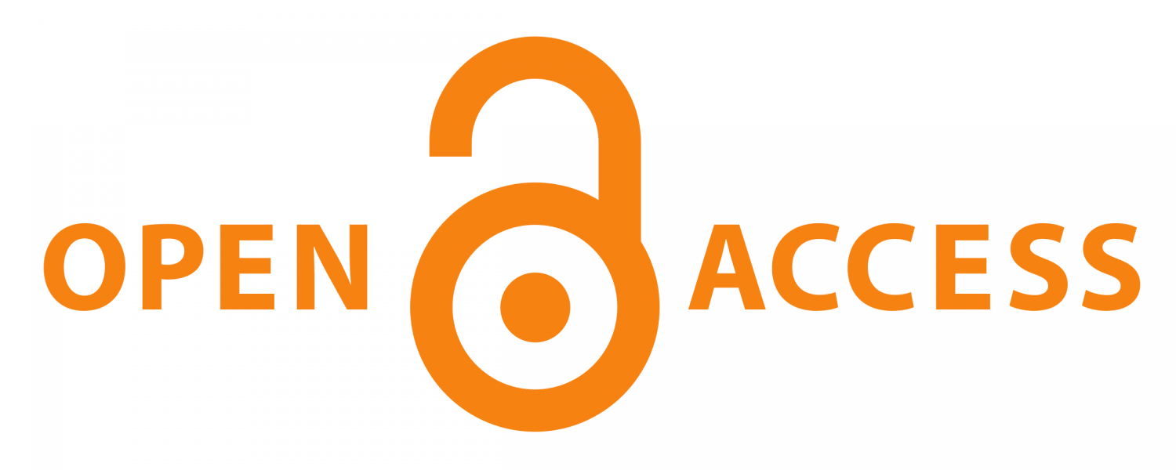

Open Access vs OER
Open Access (OA) is digital, online, free of charge, and free of most copyright and licensing restrictions (Suber, n.d.).
Open Educational resources (OER) are teaching, learning, and research materials that can be freely downloaded, edited, and shared to better serve all students
~ OER Comms
Notes:
When we think about open licenses, two of the most common uses are in open access publishing and in open educational resources.
Open access is an approach to scholarly communications that seeks to grant free and open online access to academic information, including publications like scholarly journals and books. A publication is defined 'open access' when there are no financial, legal or technical barriers to accessing it. Open licences are used to facilitate this.
Similar to open access, open education is movement and an approach to education that aims to remove barriers to learning by engaging in open educational practices in class and by developing and using open educational resources or OER for short. OER are learning, teaching and research materials in any format or medium that are either in the public domain or have been openly licensed that permit no-cost access, re-use, re-purpose, adaptation and redistribution by others.
When most people hear the word OER, they think open textbooks, but OER comes in all shapes and sizes. From single image or video or simulation, up to an entire course. Or even a whole degree program.

Slide 17
5R Permissions of OER
}
Retain
Make and own a copy
Reuse
Use in a variety of ways
Revise
Adapt, modify, and improve
Remix
Combine two or more
Redistribute
Share with others
without asking creators’ permission
Adapted from "The 5R Permissions of OER, " by Lumen Learning, licensed under CC BY 4.0
Notes:
The “5 Rs of Open” are a widely-cited framework proposed by open education scholar and practitioner David Wiley. When something is openly licensed, it typically carries 5 permissions, which are collectively known as the 5Rs
Open resources allow users to:
Retain (keep a copy of the content) – means you have permission to make and own a copy – so download it, copy it, store it somewhere.
Reuse (use the content in different ways) - can use it freely in a wide range of ways such as in a class, on a website, in a video - without having to request permission
Revise (modify the content; for example) - you can adapt, adjust, modify, or alter the actual content itself - maybe translate it into another language? Localize examples to be more culturally relevant? Update the content for currency? or adapt in any way to suit your needs?
Remix (use existing works to create a new work) - you can combine the original or revised content with other material to create something new (e.g., incorporate the content into a mashup). Examples like take 2 or more open textbooks and mash together different chapters; add open images and videos into an open textbook
Redistribute (share copies with others) – you can then share copies of the original content, your revisions, or your remixes with others

Slide 18
Question 2
If content can be accessed for free on the Internet, it is considered open?
www.menti.com
Code: xxxx xxxx
"Question Mark Icon" by isaiah658 is in the Public Domain, CC0
Notes:
Note: When presenting, I’d put in a real QR code that links to a live mentimeter question.

Slide 19
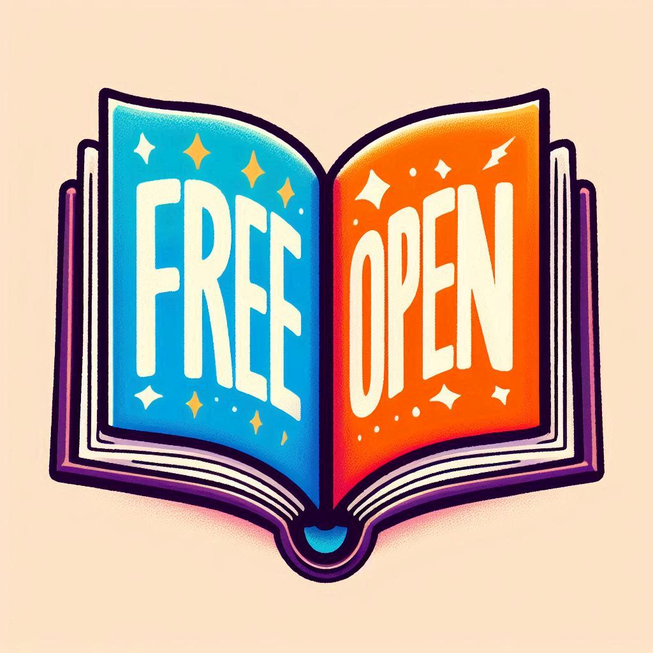
“Free” is not the same as “open”
Notes:
There are many resources that you can access for free on the web --but remember, free doesn’t equal open! Majority of things on the web are free, but not open. Most material you find online is protected by traditional “all rights reserved” copyright. But may be able to use it for educational purposes because many uses will be covered by fair dealing or the exception for educational use of material publicly available through the Internet.
To be truly open, a resource must incorporate “the 5 Rs of open”

Slide 20
Introduction to Creative Commons
Notes:
Best known and most widely used open licensing model

Slide 21
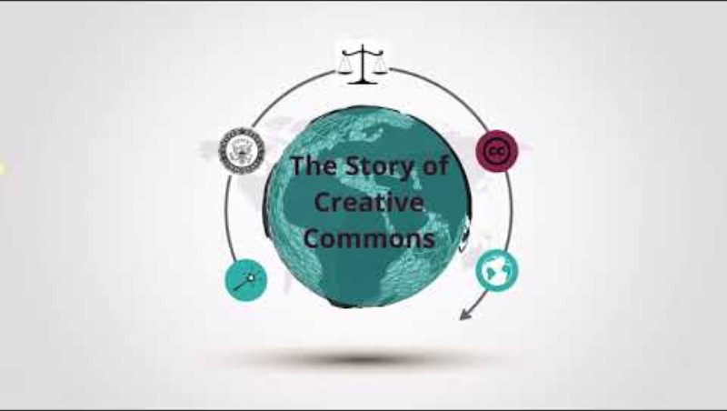
Story of Creative Commons
"The Story of Creative Commons" by Wilson College Library, YouTube is licensed under CC BY 4.0
Notes:
Watch short video about the story of creative commons.
https://www.youtube.com/watch?v=-qZDAQGkLGE
After video: Video is a bit dated: Today [2024], Creative Commons licences are used on over 2.5 billion works online (not 1.4) across 9 million websites (Creative Commons, n.d.). The CC Global Network (CCGN) has over 700 members and 45 chapters around the world.

Slide 22
Creative Commons
Notes:
Creative Commons (CC) licenses were created to provide a balanced alternative to the traditional "all rights reserved" copyright system. They address legal issues and allow creators to mark their work for specific uses within copyright law. Which basically means – that Creative Commons have hammered out the related legal issues and created ways to confidently mark a creative work for other kinds of use within the bounds of copyright law​
A content licence is a document that states the freedoms and limitations that you apply to your work – an explanation of what someone can and cannot do with what you make.​
CC licences have been translated into many languages and jurisdictions all around the world, so they are designed to work internationally.​
In open educational resources or open access materials, CC licenses help creators specify how others can use their work, including the 5R rights.
When authors assign a CC licence to their work, they retain copyright, but grant certain public rights to reproduce and distribute their work without needing permission.
CC licenses last as long as copyright and cannot be revoked once applied. It's important to understand the implications before using them, but they offer a clear way to share creative works legally.

Slide 23
Three Layers of a CC Licence
Legal Code
Base layer with legally-enforceable terms and conditions
Common Deed
Summarizes the legal code to make it more readable and accessible by people who are not lawyers
Machine Readable
Summary of legal code for each licence so that it can be read by search engines, applications, and other technology
Notes:
Each CC license has three layers. Like a layer cake.
The first layer: Legal code contains the terms and conditions that are legally enforceable in court. Essentially, lawyer-readable licence full of legalese
Commons deeds explain the key licence terms found in the legal code in everyday language and are not legally enforceable. Essentially, the plain language summary for us to read
Machine readable version summarizes the key permissions and obligations of the license. So that it can be read by search engines and other technology – makes CC licensed works more findable.
The 3 layers work together to make the CC licenses easy to use and understand.

Slide 24
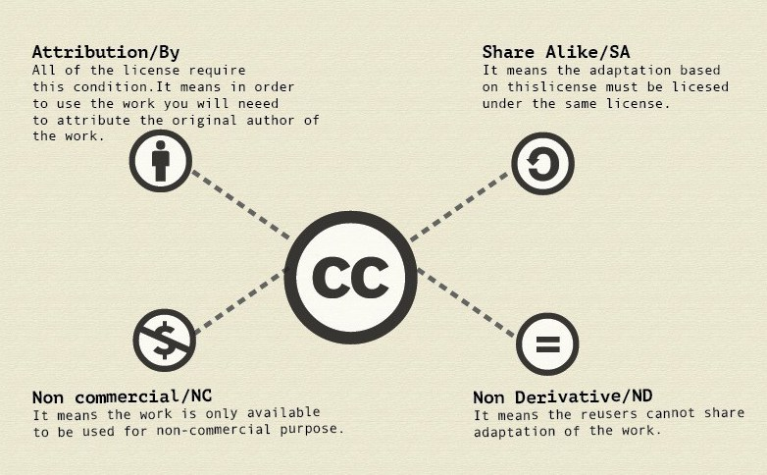
Four Creative Commons Licence Elements
“Anatomy of a CC License” by Dreamsanatomy is licensed under CC BY-SA 4.0
Notes:
Four elements that communicate how the creator does (or doesn’t!) want their work to be used. Essentially, these four license elements define the rights the user has to the work. They are indicated with a specific icon so that the licences are clearly labeled for users.
Attribution means that others may share your work so long as they credit you. All CC licences require attribution, which should include at least the original author’s name, title of work, and accompanying license.​
​
NonCommercial – Means that the work is only available to be used for noncommercial purposes. Ask yourself - do you want to allow other people to sell or make money off of your creation without having to ask you? Note that prohibiting people from using your work commercially may limit how widely it is spread. It means that no one can make any money from your work without your permission. You can work out individual arrangements for commercial use so that you can get paid when others profit from your creation.​
​
NoDerivatives - Means that reusers can’t share an adaptation of your work. They can only copy, distribute, or display the work unchanged. Prohibiting derivatives might prevent others from making and sharing something really cool out of your original. But also means they may not use your work in a way you disagree with.
​
ShareAlike: Means that any adaptation based on this licence must use the exact same licence. Ensures that the terms you chose for your original creation are preserved, but also may limit how much the derivative work can be shared (and in turn, how likely it is for someone to use your work in a derivative). On the other hand, share alike ensure that your work is always used under the terms you want, even after many generations of copies and derivatives.​
Imagine these elements to be like building blocks. They are stacked together in different combinations. It is up to the creator to choose which combination works best for them.

Slide 25
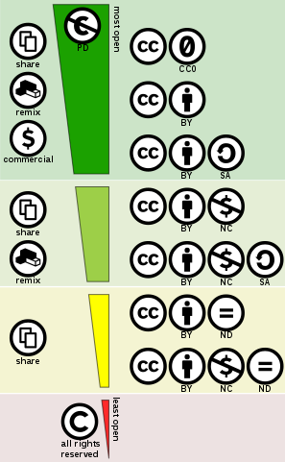
CC Licence Spectrum
Public Domain
Attribution (CC BY)
Attribution-ShareAlike (CC BY-SA)
Attribution-NonCommercial (CC BY-NC)
Attribution-NonCommercial-ShareAlike (CC BY-NC-SA)
Attribution-NoDerivatives (CC BY-ND)
Attribution-NonCommercial-NoDerivatives (CC BY-NC-ND)
Derivative of the image “Creative Commons License Spectrum” by Shaddim licensed under CC BY 4.0.
Notes:
Four elements are mixed and matched to make up the 6 licences.
Go through the categories from most open to least open
Public domain (more on that in a minute)
CC BY: Others can do pretty much whatever they want with your work, as long as they say who the work was originally “by” (this is attribution) This is the most “open” license.
CC BY-SA: Others can do pretty much whatever they want with your work, as long as they attribute you and, if they change it, license any changed work in the exact same way. (SA=share alike)
CC BY-NC: Others can use and change your work if they credit you, even license the changed work differently, but they can’t make money off it (NC=Non-commercial).
CC BY-NC-SA: Others can use and change your work if they credit you and aren’t making money off of it, but they have to license any changed work in the same way as the original.
CC BY-ND: Others can use your work if they credit you, but they can’t share any changes to it (ND=no derivatives). (Share, but also use commercially)
CC BY-NC-ND: Others can use your work if they credit you, but they can’t share any changes and they can’t profit from it (NC and ND).
Traditional Copyright: All rights are reserved – so you can’t use, adapt, copy, or publish without creator’s permission
Reminder: what you find online is under traditional copyright unless otherwise specified

Slide 26


Public Domain Tools
CC0
Use if you want to waive all copyright and related rights for work that YOU have created
Public Domain Mark
Used for works that have been identified as being free of known restrictions under copyright law
“CC0 Icon” and “Public Domain Icon” by Creative Commons, licensed under CC BY 4.0.
Notes:
In addition to the 6 CC licences, are two additional designations.
Public Domain Tools are two ways that something may be marked as public domain:
CC0 – creator waives all rights and release own work into the public domain – basically saying “no rights reserved.”
Public Domain Mark – label to mark works known to be free of all copyright restrictions.
For example, Shakespeare’s works are in the public domain because he’s been dead for centuries. But, you can’t just scan and up upload your copy of Hamlet. The text of that work may be in the public domain, but the formatting and overall presentation of the work in your Penguin Classics edition (and especially the content of footnotes or endnotes) are the intellectual property of someone else. Locate the basic full text somewhere like in Project Gutenberg or Wikisource and let your students have that. Or transcribe the original yourself.
There are no restrictions on using works that are in the public domain, which means you can use them however you want. Unfortunately, it's not always easy to tell whether or not something is in the public domain. There may be some cases when you know for sure that a work is public domain (for instance, it’s clearly labeled CC0). But if you aren’t sure, talk to the Intellectual Property Office. I can provide general help, but they’re the real experts.​
​

Slide 27
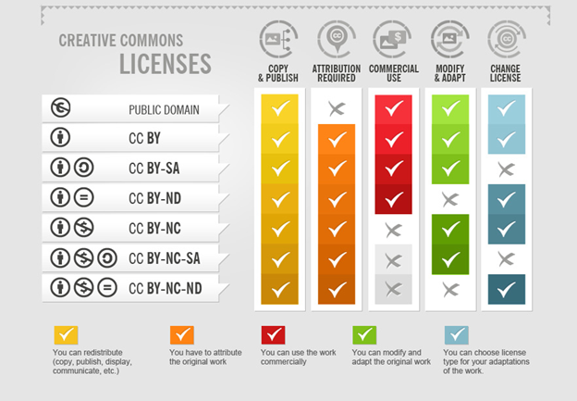
How To Attribute Creative Commons Photos by Foter is licensed under CC BY-SA 3.0
Notes:
Here’s another way of explaining what you can do with each CC licence

Slide 28
Exceptions and Limitations
fair dealing
compulsory licensing schemes
Marrakesh Treaty
Indigenous knowledge & cultural expressions
public domain
Notes:
CC licenses work within copyright law so apply only to work that is within the confines of copyright. CC licenses do not apply to situations that are outside of copyright restrictions such as:
Fair dealing: allows certain uses of copyrighted material without permission for the purpose of research, private study, education, parody, satire, review, or news reporting
Compulsory licensing schemes: Makes copyrighted content (e.g., music) available for reuse without asking permission, but a fee is paid to the rights holder \
Under the Marrakesh Treaty: Allows people with disabilities to copy and modify works for accessibility so they can engage with and understand content
Public Domain: works are free of copyright so no permission is needed to copy, use, adapt, or share
Indigenous knowledge & cultural expressions: Is not protected by copyright, but it is important to respect cultural rights, interests, and customs. Consult with relevant communities before reuse or posting
Other rights, such as patents, trademarks, privacy and publicity rights may restrict how the work is used outside of copyright and CC licenses do not impact these other rights

Slide 29
CC Licence Spectrum: OER vs Not OER
Public Domain
Attribution (CC BY)
Attribution-ShareAlike (CC BY-SA)
OER
Attribution-NonCommercial (CC BY-NC)
Attribution-NonCommercial-ShareAlike (CC BY-NC-SA)
Attribution-NoDerivatives (CC BY-ND)
Attribution-NonCommercial-NoDerivatives (CC BY-NC-ND)
NOT
O
ER
Traditional “all rights reserved” copyright
Derivative of the image “Creative Commons License Spectrum” by Shaddim licensed under CC BY 4.0.
Notes:
But CC BY-ND and CC BY-NC-ND are not OER compatible licences because the public can’t revise or remix them. Because they don’t meet all 5 Rs, they are not OER.
Open Access (OA) and Open Educational Resources (OER) are both part of a broader movement of making scholarly research, data, science, and educational materials open and free to use for all. Both Open Access (OA) and Open Educational Resources (OER) aim to increase access to knowledge but serve different purposes. OA makes research outputs freely available to scholars and the public, often under licenses that allow free access but not necessarily adaptation or reuse. OER, however, provide educational materials that can be freely accessed, adapted, and redistributed. Essentially, OER are a subset of OA materials. While all OER are OA, not all OA materials are OER. Works with ND (No Derivatives) licenses are considered OA but not OER, as they don't allow modifications. Both OA and OER use Creative Commons licenses, but OER specifically require licenses permitting derivative works to meet the 5Rs.

Slide 30
Using CC Licences

Slide 31
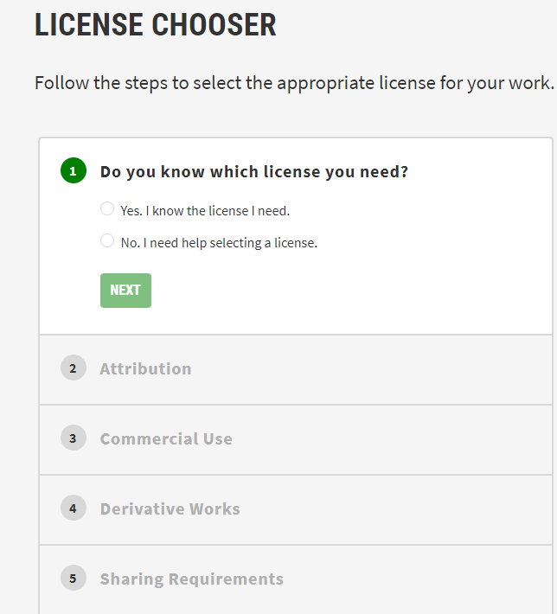
Apply a CC Licence
Choose appropriate licence for your work
Apply the licence to your work
Tip: Use the CC License Chooser to help choose the licence and get the code/text: https://chooser-beta.creativecommons.org/
Notes:
Use the CC Licence Chooser (https://chooser-beta.creativecommons.org/ ) to help you select a license for a work you’ve authored and have the rights to openly license. It walks you through a decision tree with a series of questions that help you identify the right license for your work. There is no single answer for which CC licence is the best. Consider why you are sharing and what you hope others might do with your work, before making your CC licence choice.
Click on the image to open the website → walk through using the tool, including the code at the bottom
The Chooser includes the code that you can just copy and paste on to the work you are licensing, or at the bottom of the page if you’re licensing a whole page/blog/site
If it’s print work or media, just copy and paste the text from the Licence Chooser on the title and/or copyright page of your print work or presentation, or in the credits of your media

Slide 32
Group Activity: Choosing a Creative Commons Licence
Each group will be given a scenario to consider. Use the CC License Chooser to assign a Creative Commons license to said work.
Notes:
15-20 minutes
Break attendees into groups. Ideally at least 6 groups (so two different groups per scenario). No more than 4 people per group.
Try to ensure that more than one group is assigned to each scenario.

Slide 33
Group Activity: Scenario
Group | Scenario | Goal
A | You’re an early career professional illustrator who is paid per project. | You want folks to share your illustrations widely for exposure.
B | You’re a tenured professor at a university who creates ancillary materials (e.g., test banks, videos) for your students. | You want your colleagues to use and adapt resources you create, but you want to be attributed for your work.
C | You’ve published commercial textbooks in the past but are currently authoring an openly licensed textbook. | The commercial publisher you previously worked with keeps asking when your open textbook will be published.
https://chooser-beta.creativecommons.org/
Notes:
(Up to 10 minutes for discussion out of the original 15-20 minutes)

Slide 34
Group Activity: Group Discussion
Which licence did you choose? Why?
Notes:
Group Discussion (Up to 10 minutes): Ask all the groups assigned to each scenario (i.e., all A), which licence they chose and why. Compare the similarities and differences for rationale
Is it the same as the other group(s) assigned to the scenario?
Takeaway: there isn’t a correct answer.

Slide 35
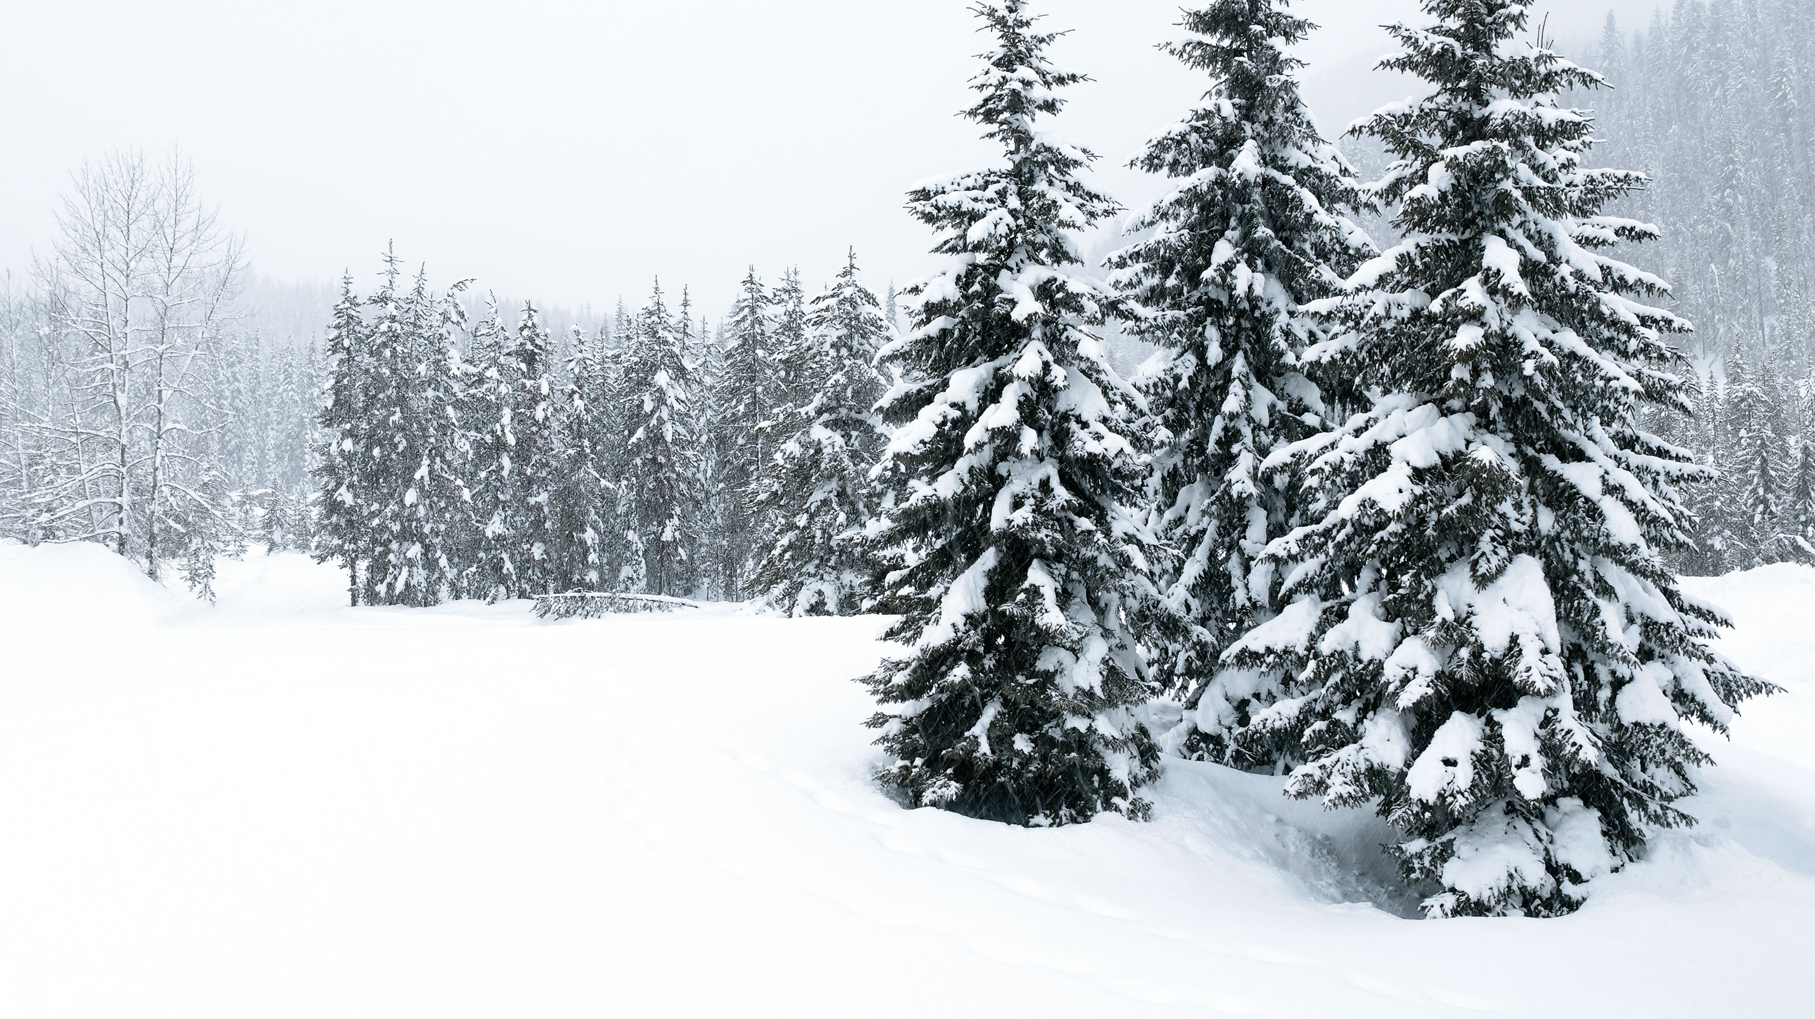
5-minute break

Slide 36
Finding Creative Commons Material

Slide 37
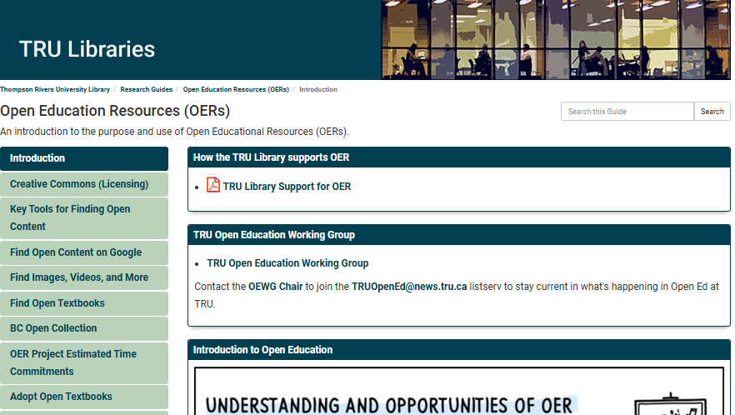
TRU Library LibGuide
Notes:
Reusing existing CC content can save significant time and effort because you aren’t starting from scratch. You can use them as is or use them as a base to build your development efforts​
​
Unlikely that you will find something that perfectly fit your needs. When you find one, remember that most can be used in whole or in part and/or modified/customized to fit YOUR needs. But you can leave as is, if you want.​
To find existing CC material that you may want to use or adapt, check out the library’s OER guide [https://libguides.tru.ca/oer]. It has links to recommended repositories to find CC materials – from open textbooks to images, videos, courses. Also tips on finding open content on Google. ​And suggestions on how to assess the quality of OER​.
And connects you to the Open Access guide for more on that type of openly licensed content. One of the best repositories of open access publishing is the DOAJ (Directory of Open Access Journals) and DOAB (Directory of Open access books)
​
​I also highly recommend that you set up a meeting time with me before proceeding (see the "Contact Me" box on this page). I am happy to share my expertise and it is likely to greatly reduce the time you spend on this endeavor. If you want to plow forward on your own, that’s fine, too.​
[Action: Click on slide to go to LibGuide and point out some of the sections]
​
Though the resources you find through these links should be open, always confirm that the material you wish to use has a Creative Commons or similar license that explicitly allows you to use and/or modify the material.​ Things change. For example, both unsplash and pixabay used to use CC0, but now use own custom open licenses.

Slide 38
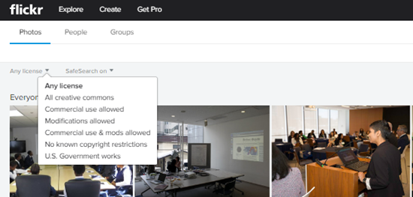
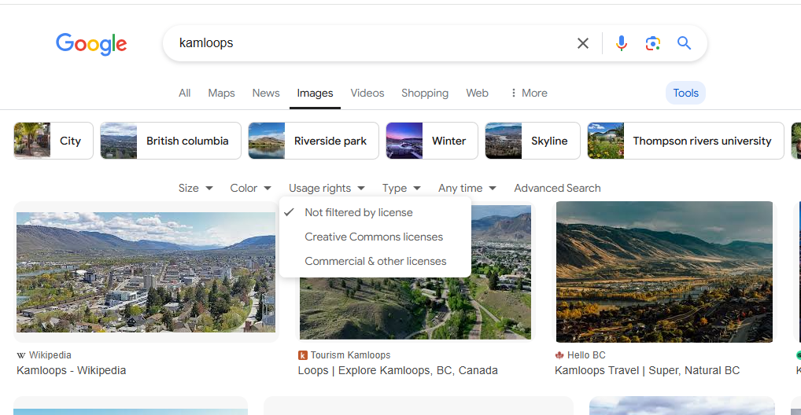
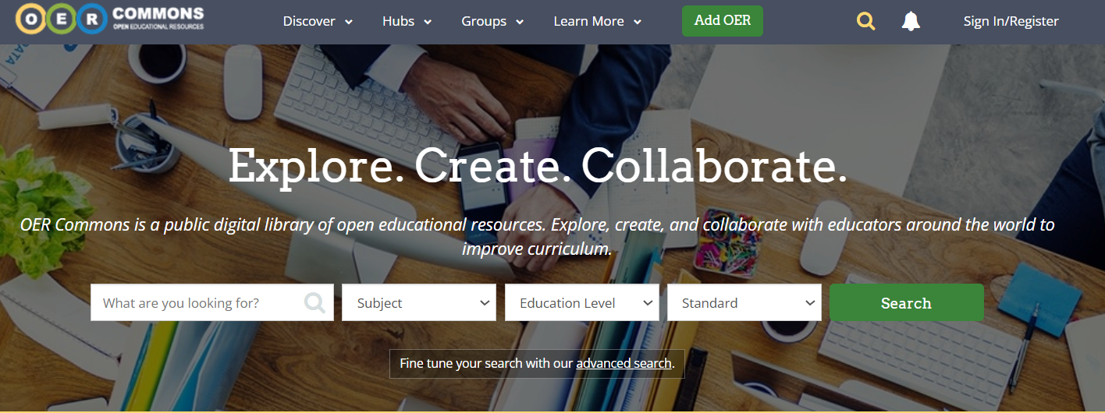
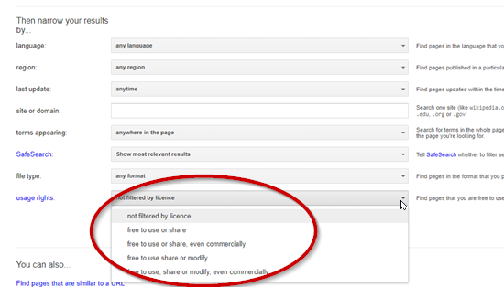
Finding CC Material
Google: Images
1
2
3
Google: Advanced Search
Notes:
If you are looking for images to include in a presentation or to illustrate content in some sort of text, Flickr and Google Image search both have a creative commons search. The challenge with using Google as your primary search tool is that most OER are collected electronically in some form of repository, which Google doesn’t often search well. There are numerous repositories and you have to decide, which ones satisfies your needs. That’s why we looked at some of the other repositories first.

Slide 39
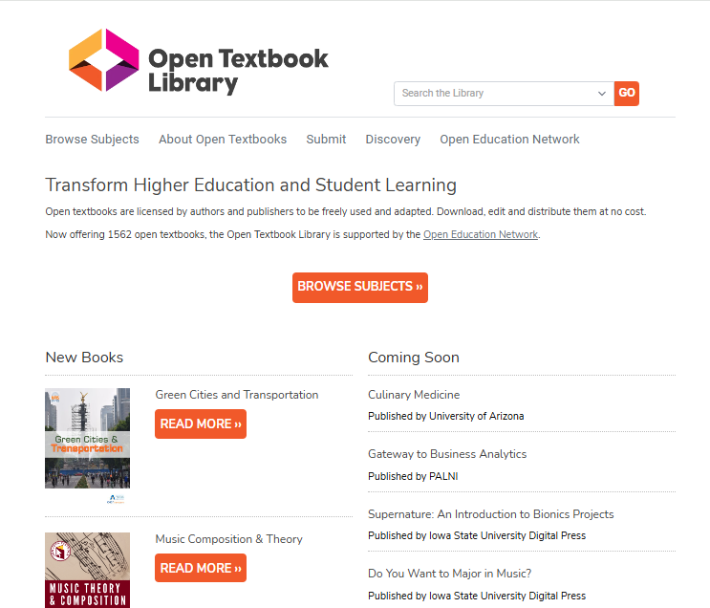
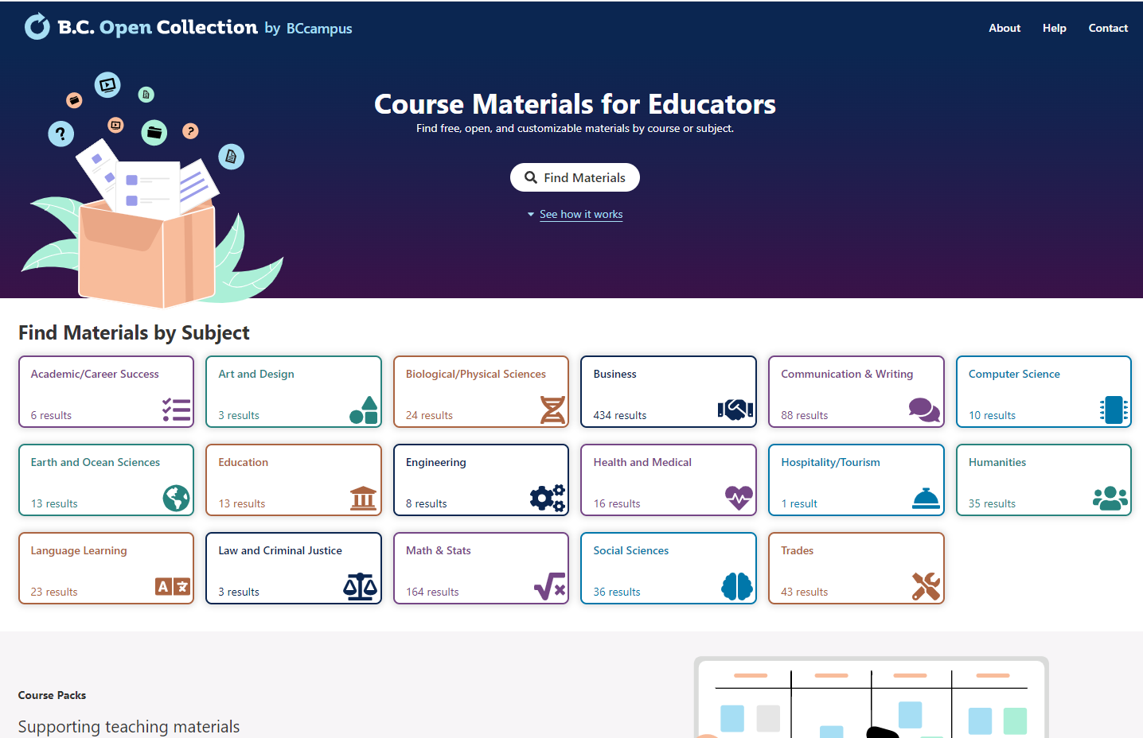
Finding Open Textbooks
Notes:
For Finding Open Textbooks, I usually recommend starting with BCcampus or the University of Minnesota’s Open Textbook Library. Then eCampus Ontario or LibreTexts. All the links are on the library’s guide

Slide 40
Individual Activity: Part 1
Go to the TRU Library OER LibGuide’s “Find Images, Videos, and More” tab, and select one of the image repositories to explore.
Find one CC-licensed image related to your discipline that meets the criteria to be an OER.
NOT: Pixabay or Unsplash because they don’t use Creative Commons licences
On your designated Google slide, copy and paste the image and the CC licence.​
OER LibGuide: https://libguides.tru.ca/oer
Google slide: https://bit.ly/412BVi7
Notes:
Walk through instructions. Remind them we are just looking at finding an image and pasting the CC licence. Ignore the Attribution section at the bottom of the page
https://docs.google.com/presentation/d/15m3cxSaovrLspj4mVf-1lb_ritdTCAkK1j_bdwnIJ9o/edit?usp=sharing ​

Slide 41
Remixing & Adapting CC Material
Notes:
One of the cool things about CC material is that you can build upon it. CC licenses that allow for adaptations to be shared (i.e., all except BY-ND and BY-NC-ND) grant permission to others to create and redistribute adaptations when doing so would otherwise constitute a violation of applicable copyright law. ​

Slide 42
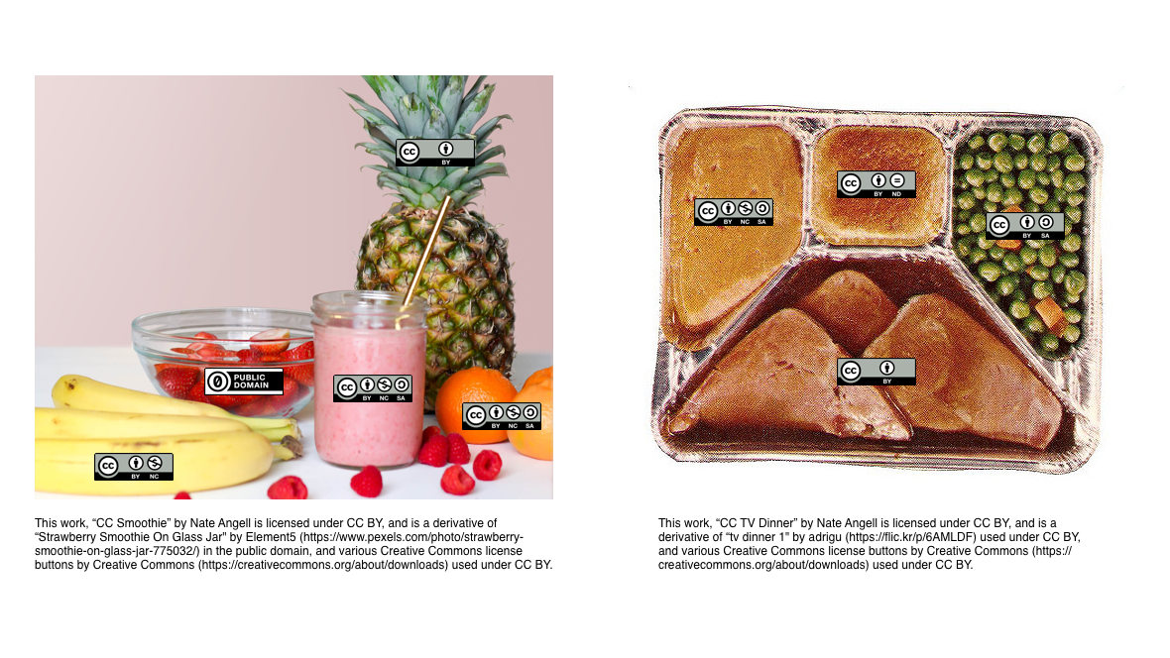
Adaptations vs Collections
Adaptations
Collections
Notes:
In the Creative Commons world, the terms adaptation, derivative work, and remix are used interchangeably. I usually use adaptation or remix.
An adaptation creates something new from existing works by adding layers of creativity and interpretation, remixing them into a new creation. They are like a smoothie, blending or remixing sources so you can’t tell where one ends and another begins. Examples include translating a book, writing a screenplay from a novel, or remixing a song. These works are based on the original but transformed to be unique. However, works are adapted, be sure to provide attributions for the works you used to create the adapted work. (talk about more in a bit)
So the adaptations could be remixing a couple of existing Creative Commons Resources. Or, it could be you making significant changes and revising a single CC licensed work.
Not all changes create an adaptation. Correcting typos or changing formats (such as PDF to HTML) isn’t an adaptation under Creative Commons. The work must be sufficiently different with some ‘original expression,’ though ‘originality’ varies by jurisdiction.
A collection is a compilation of separate, independent works that are assembled into a single unit. Each work in the collection retains its original form and copyright. The individual works are not altered or combined in a way that changes their original meaning or purpose. They are simply grouped together for convenience or thematic reasons. They have been compared to TV dinners. The different works are compiled together but also are also organized as separate and distinct objects. Examples include a selection of open-access academic articles, a curated set of CC-licensed photographs on a particular theme, or a compilation of CC-licensed music tracks.

Slide 43
Adaptations vs Collections: Licensing Considerations
Adaptations
Collections
Licensing Considerations
Original CC-license continues to apply to an adapted work, even after it has been adapted.
If the original underlying work is licensed with:
NoDerivatives (ND): you can make and use changes privately, but you cannot share your adaptation with others
NonCommercial: you may want to use NC element too, to make downstream reuse easier
ShareAlike (SA): you must use the same licence as the original
Licensing Considerations
No need to apply a ShareAlike (SA) license to your entire work, even if it includes SA-licensed content
NoDerivatives (ND) restriction does not prevent you from using ND-licensed content
Can combine CC-licensed material with other works, provided you attribute it and comply with any NonCommercial restriction
Notes:
Adaptations and collections both have licensing considerations that need to be considered.
For Adaptions:
Remember that the original CC-license continues to apply to an adapted work, even after it has been adapted.
If the underlying work is licensed under a NoDerivatives license, you can only make and use changes privately. You canNOT share your adaptation with others.
Underlying work includes a remix of an NC-licensed work, use NC element to make downstream reuse easier.
Underlying work is licensed under a ShareAlike license, then ShareAlike applies to your adaptation and you must license it under the same or a compatible license. This class PowerPoint is licensed under a SA licence because I use some SA content.
For collections:
you don’t need to apply a ShareAlike (SA) license to your entire work, even if it includes SA-licensed content, since it does not contain adaptive work.
NoDerivatives (ND) restriction does not prevent you from using ND-licensed content
But if any of the original works in the collection are licensed under one of the NonCommercial CC licenses, then the compiler must choose a licence that includes the NonCommercial element for the collection.
[Really nitty-gritty, so come talk to me if you have questions about those special considerations for adaptations and collections]
In short: collections compile independent works, while adaptations modify existing content to create something new. Each has different licensing considerations.

Slide 44
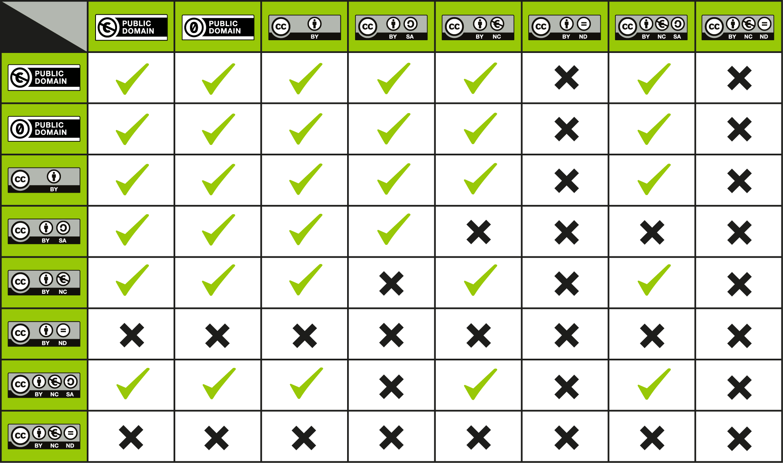
CC Compatibility Chart
“License Compatibility Chart” by CC Wiki, is licensed under CC BY 4.0.
Notes:
Because CC licenses can stack on top of each other, you need to think about whether they are compatible with each other when you’re authoring or adapting an openly licensed resource.
Adapting or remixing works with different licenses can be tricky. You need to consider ‘license compatibility,’ which addresses which licensed works can be adapted and how.
Use this CC License Compatibility Chart as a guide if you want to remix or combine two different CC licensed work. To use the chart, find a license that applies to one of the works on the left column, say for example, Attribution ShareAlike [click] and the license that applies to the other work on the top row, for example Attribution NonCommercial. If there is a check mark in the box where that row and column intersect, [click] then the works under those two licenses can be remixed. If there is an “X” in the box, then the works may not be remixed unless an exception or limitation to copyright applies. In this case, the licences are not compatible so they should not be remixed.
If you make adaptations of material under a CC license (i.e. “remix”), the original CC license always applies to the material you are adapting even once adapted. The license you may choose for your own contribution (called your “adapter’s license”) depends on which license applies to the original material. Recipients of the adaptation must comply with both the CC license on the original and your adapter’s license.​
​
Note that the ND licenses do allow you to reproduce the material in unmodified form together with other material in a collection​, you just can’t share adaptations.

Slide 45
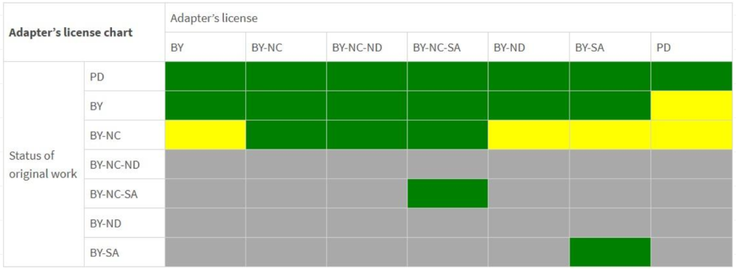
CC Adapter’s Licence Chart
“Creative Commons Adapter’s License Chart” by Creative Commons is licensed under CC BY 4.0
Notes:
When applying a CC license to your adapted work, remember your rights only cover your contributions. The original license still governs the reused elements and can affect your licence options. Consult the Creative Commons Adapter’s License Chart to decide which CC license to apply. To use the chart:
Find the original work’s license in the left column [click]
Pick an adaptor’s license you want to use from the top row. [click]
Note the colour at the intersection:
If it’s green: Go ahead and use the adaptor’s license.
Yellow: Caution! Technically allowed but not recommended due to complexity in marking multiple copyrights.
Gray: Not allowed. Choose another license."

Slide 46
Attributions
Notes:
When you find Creative Commons (CC) licensed materials which you wish to integrate into your own teaching, research and scholarship, it is important to provide appropriate attribution to the creator(s) of the CC work you are using.

Slide 47
How is attribution different from a citation?
Citations give credit when you use someone else’s ideas or words in your own work. They tell your reader where ideas that you quote, paraphrase, or summarize, came from.
Attributions give credit when you reuse or reproduce someone else’s work. Whenever you use an OER, you must attribute it.
Says to the reader:
“I base my thinking on this other person’s work, which you can find by following my citation.” ​
Says to the reader:
“I have permission to reuse this other person’s work, which you can find by following my attribution.”
Adapted from “Citations vs Attributions” by Amy Hofer for Open Oregon Educational Resources, licensed under CC BY 4.0 which was adapted from Citations vs. Attributions by Quill West, Open Education Project Manager, Pierce Community College, CC-BY 4.0.
Notes:
Both citation and attribution give credit to others – they’re part of using information ethically. ​
​
Citations give credit when you use someone else’s ideas or words in your own work. They tell your reader where ideas that you quote, paraphrase, or summarize, came from. A citation says to the reader: “I base my thinking on this other person’s work, which you can find by following my citation.”​
Attributions give credit when you reuse or reproduce someone else’s work. It says to the reader: “I have permission to reuse this other person’s work, which you can find by following my attribution.” Whenever you use CC licensed work or other openly licensed work → you need to attribute it​
​
SO, Think of citations as fulfilling an academic purpose, and attributions as serving a legal purpose.​
Because they serve different purposes, you cannot replace one with the other, even though they have similar rules and parts.​

Slide 48
Attribution: TASL
T – Title
A – Author
S – Source (usually link)
L – CC Licence
If you modify, note what you change
Notes:
Include the following information when attributing others CC licensed materials:
Title: title of the work: What is the name of the material
Authors: The name of the author / creator: Who owns the material? It could be an individual (or a group of people), could be a company, could be a pseudonym. Could be chosen to be anonymous. Just use whatever the creators requested. If the author has a webpage, link to it.
Source: Link to the original source. Hyperlink title to the original source.
Licence: Indicate the type of licence it is available under because that states how it can be used. Use the exact name of the CC licence (and version if provided). Use the acronyms instead of the full name of the licence. Hyperlink the licence name to the licence deed page.
Note: Not required liked the rest of them, but it is nice to add the name of the organization that sponsored/managed the work you are adopting.

Slide 49
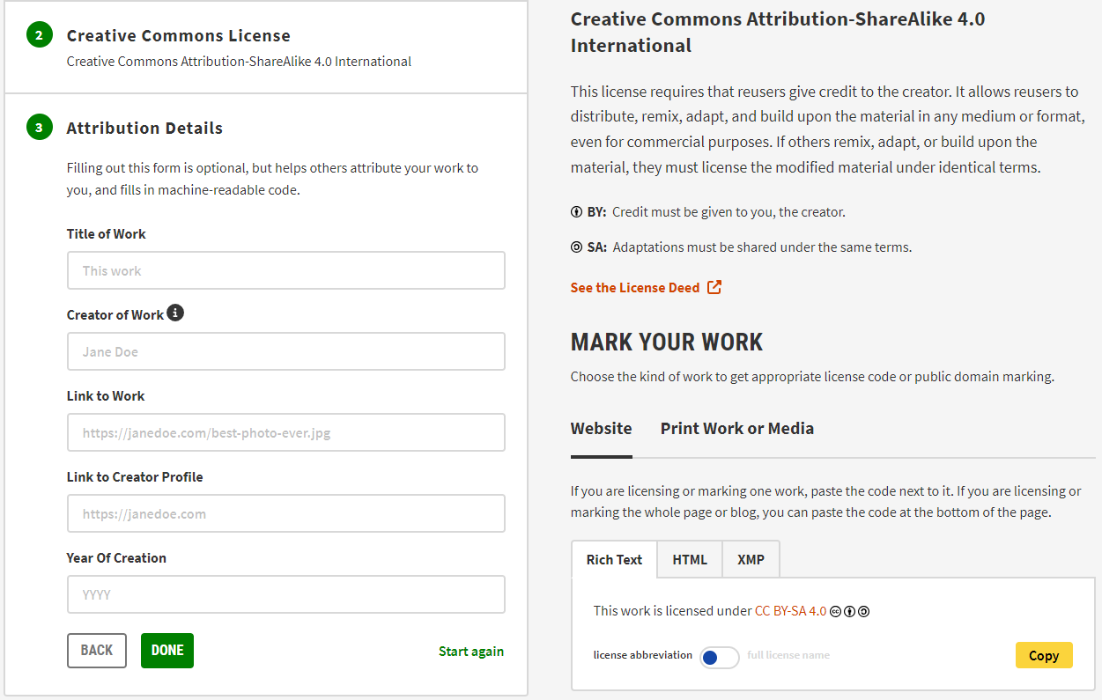
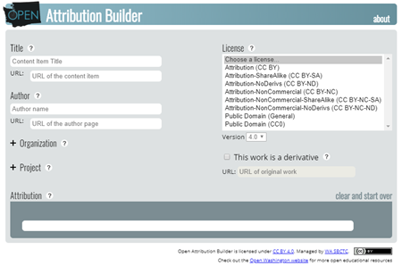
Attribution Builders
CC License Chooser:
https://chooser-beta.creativecommons.org/
Open Attribution Builder: http://www.openwa.org/open-attrib-builder/
"Open Attribution Builder" by Open Washington, Washington State Community and Technical Colleges is licensed under CC BY 4.0
“CC License Chooser" by Creative Commons is licensed under CC BY 4.0
Notes:
Easiest way to do this is to use an attribution builder. But many tools (like PressBooks) have one built in that you can use.
CC License Chooser also provides a form at the end of the tool to create an attribution for the work, as well as Rich Text, HTML, and XMP license formatting for the web.
Open Washing also has a great attribution builder that you just have to plug in the details, select the licence and version, and then copy and paste the attribution. It also includes an option on how to denote if it is a derivative work or adaptation.

Slide 50
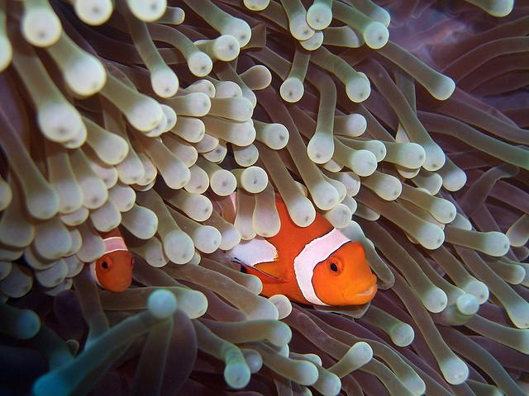
Option 1: Photo by Samuel Chow / CC BY 4.0
Option 2: Photo: Creative Commons
Notes:
Group Discussion: What do we think about these two options for attributing this image? Do either meet TASL requirements? Why or Why Not?
Option 1 ➔ OK, should state the title, but at least it’s linked. Also has the author and link to the source. And has the licence and links to the licence deed.
Options 2 ➔ totally wrong. No title. No Author. Creative Commons is not the author. No link to the original photo source. No mention of a licence, let alone a link to one. Creative Commons is an organization.
This is why I recommend using an Attribution Builder – It helps you get all the needed parts in the right order.

Slide 51
"Clownfish and Sea Anemone 2" by Samuel Chow is licensed under CC BY 4.0.
Notes:
Example of an attribution directly under the image. You can place attributions at the site, or at the end of the page – just pick a way and be consistent. This attribution was built using the Open Washington tool
Attribution: "Clownfish and Sea Anemone 2" by Samuel Chow is licensed under CC BY 4.0

Slide 52
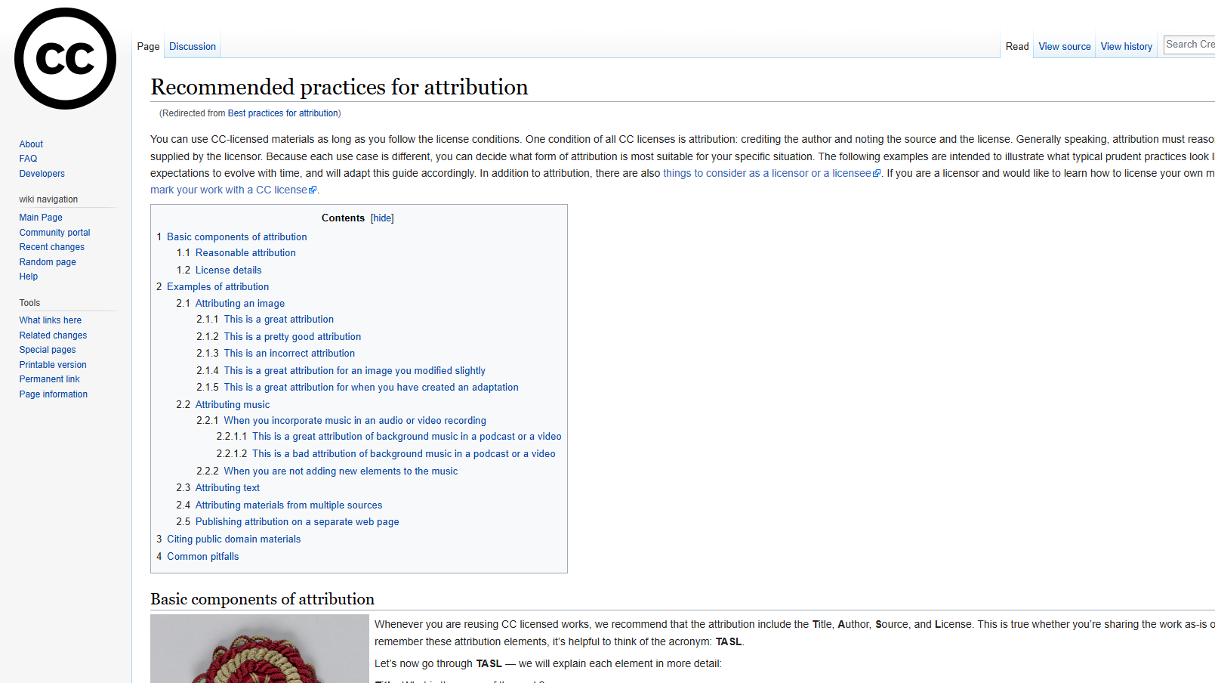
CC Wiki Recommended practices for attribution
Notes:
If you don’t have access to one of the attribution builder, or if you’re doing something different or more complicated, check out the Creative Commons Wiki’s guide on recommended practices for attribution: https://wiki.creativecommons.org/wiki/Recommended_practices_for_attribution

Slide 53
Individual Activity: Part 2
Using the image that you found for Individual Activity: Part 1, go to an attribution builder and build the attribution for your image.
Copy and paste the attribution into the designated textbox on your Google Slide
Open Attribution Builder: https://www.openwa.org/attrib-builder/
CC License Chooser: https://chooser-beta.creativecommons.org/
Google slide: https://bit.ly/412BVi7
Notes:
[10 minutes]

Slide 54
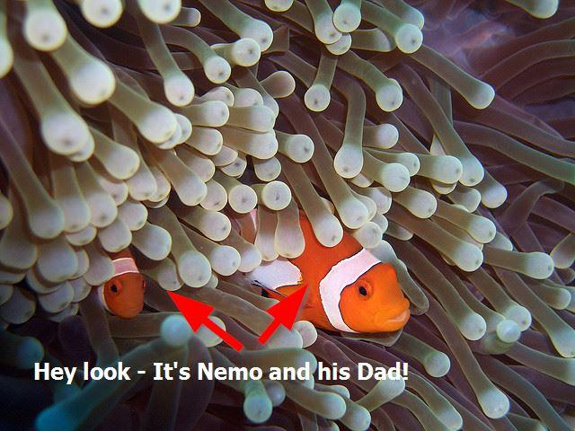
“The Real Nemo and Marlin” is a derivative of the image Clownfish and Sea Anemone 2" by Samuel Chow licensed under CC BY 4.0. / “The Real Nemo and Marlin” by Brenda Smith is licensed under CC BY 4.0.
Notes:
Throughout today, we’ve discussed how you can build upon another’s work to make an adaptation or derivative. Here is a (not very creative) example of a derivative or adaptation. It’s the original image that I used for showing an attribution. But then I drew some arrows and added some text onto it.
Note that the attribution statement includes my title for the work, my name, and my licence. It also acknowledges that it is derived from the original, and includes all the information for it. I could have said “is adapted from” instead of “is a derivative of.” Either works.

Slide 55
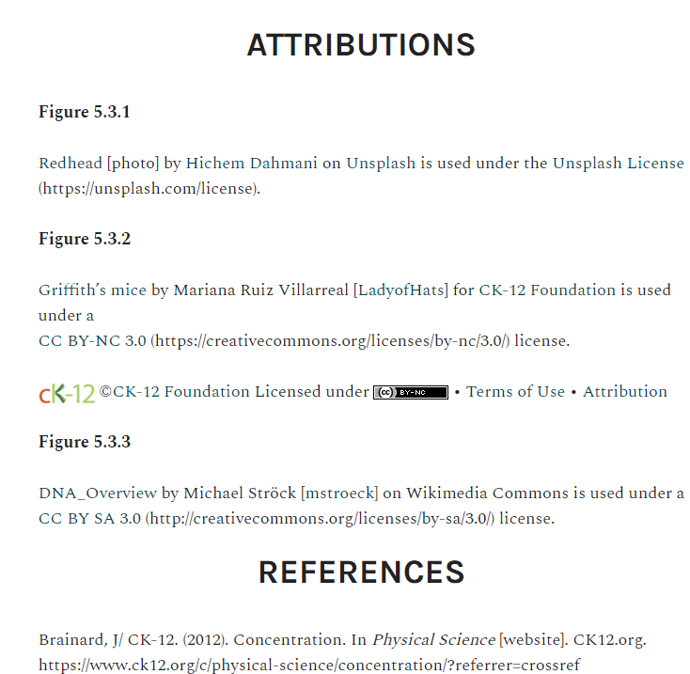
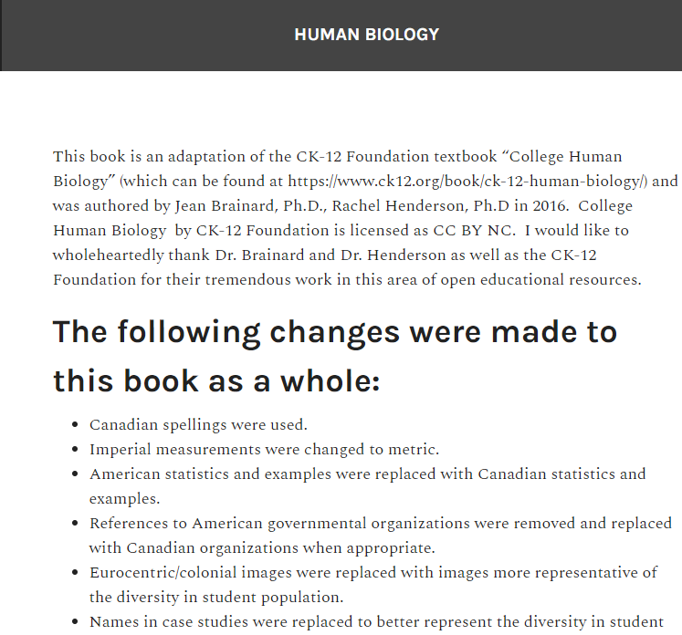
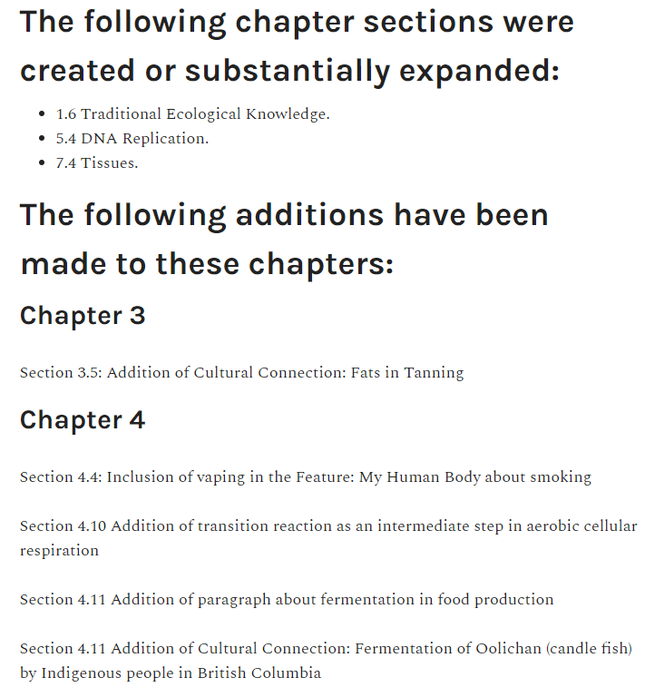
Sample Attributions
"Human Biology: Human Anatomy and Physiology" by Christine Miller is licensed under CC BY-NC 4.0
Notes:
For example, this adaptation to an open textbook make some changes to the text, added in H5P interactives, and embedded videos in such a way that the reader can’t tell just by looking at it what was from the original work and what the adapter added. At the end of each chapter, it includes attributions of all the openly licensed resources used in the chapter. [click] It’s also indicates any changes or modifications that the adaptation made to the original works at the end of the book in separate “Statement of Adaption” section

Slide 56
Creating and Licensing Your Own Work
Explore the TRU Library LibGuide to find existing CC-licensed works that you could build upon
Use the CC Licence Chooser to help you choose your licence
Refer to the CC Licence Compatibility Chart to determine if a licence allows for remixing or adapting
Consult the CC Licence Adapter’s Chart to see which CC licences an adapter can use, based on the status of the original work
Use an Attribution Builder to build your attribution statements
Include the licence (with the links to the deed) on your work
Share your CC work with others
Notes:
Reminder about using the tools we’ve discussed to apply a CC licence to your own work [review each]
Then, share out your work. It’s a great way to increase the visibility of your work, build your sphere of influence (for tenure and promotion), and possibly find some collaboration opportunities

Slide 57
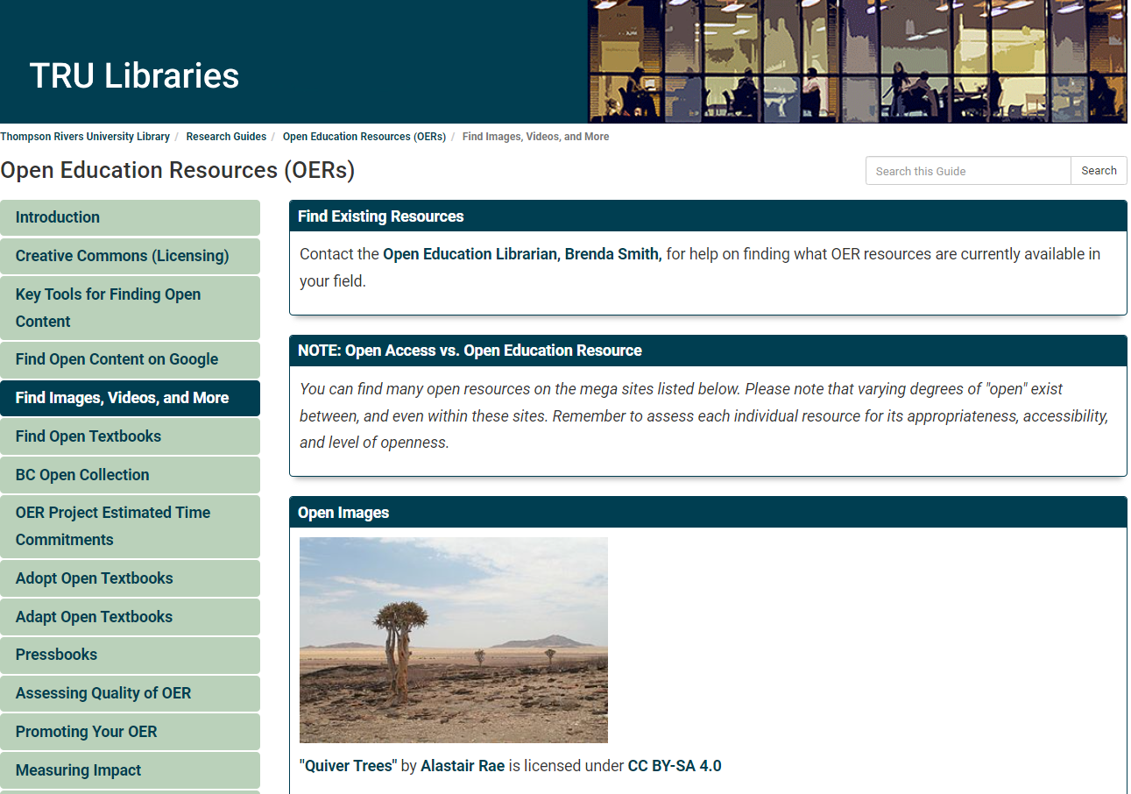
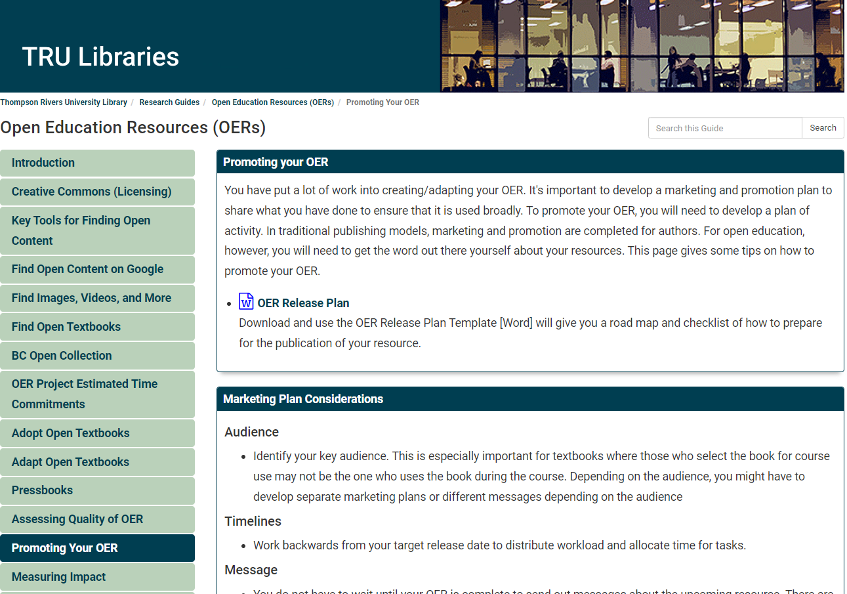
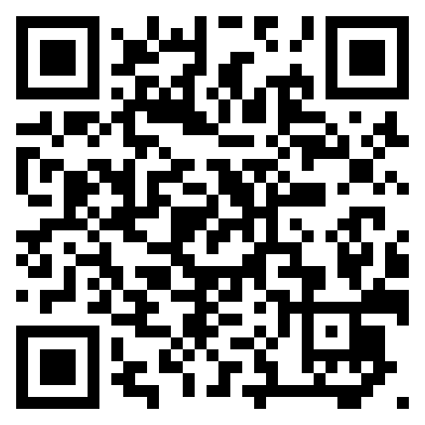
Where can I share my work?
Notes:
When you’ve created something that you want to share, check out the library’s OER guide for possible repositories to submit your work to and the promoting your OER tab for tips on how to launch promote your OER to others.

Slide 58
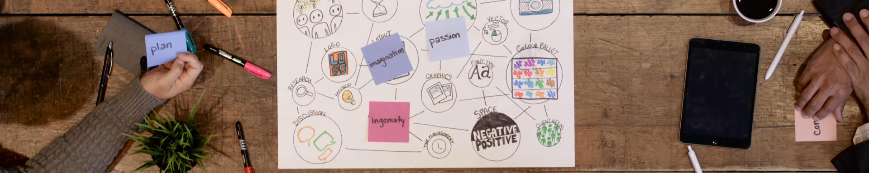
Getting Started with Advocating for Open Licensing and OER
Educate yourself and others
Join Communities
Notes:
By 2024, Creative Commons licences are used on over 2.5 billion works online across 9 million websites (Creative Commons, n.d.).
If you’re interested in getting involved in the open community and advocacy
Educate yourself and others: learn about open licensing and OER and share the knowledge with your colleagues and peers. Coming to this workshop is a great start
Join Communities: Participate in online forums, social media groups, and local meetups focused on open licensing and OER.

Slide 59
Open communities
Go Open!
CC Global Network (CCGN)
URL: network.creativecommons.org
email: network-support@creativecommons.org
Canada OER
URL: https://open.bccampus.ca/what-is-open-education/canadas-open-education-initiatives/
BCOpen & BCcampus
URL: https://open.bccampus.ca/what-is-open-education/bcopen-b-c-s-community-email/
TRU Open Education Working Group
URL: https://oewg.trubox.ca/
Notes:
Internationally, CC Global Network (CCGN) provides a place for everyone interested in open licensing and shared knowledge; it has over 700 members and 45 chapters around the world. The Network Platforms provide a place volunteers to collaborate on activities and projects related to open education, copyright, and open culture.
Nationally, there is the Canada OER mailing list, submit a request from the CanadaOER subscription page or email open@bccampus.ca
Provincially, there is the BCOpen Listserv and, of course, there’s lots of resources and opportunities through BCcampus
Locally: At TRU, become involved in the TRU Open Education Working Group. We meet once a semester, and anyone at TRU interested in open is welcome.

Slide 60
Getting Started with Advocating for Open Licensing and OER
Educate yourself and others
Join Communities
Create and share your work with a Creative Commons Licence (open access publications for scholarship and OER for your teaching materials)
Advocate for policy change
Notes:
Create and share your works with an open licence. Share your open access publications and your OER in the TRUspace institutional repository. TRU has open access journals, PressBooks, and Splots to help you create openly licensed works.
Advocate for Policy change: TRU’s Open Education Working group has been encouraging TRU to adopt policies that support open licensing and the use of OER. We have the TRU Open Press. Over half the tenure and promotion standards documents include open in some way.
Collaborate: Work with other educators, librarians, and policymakers to promote the use and creation of open licensed content – at TRU, through BCcampus, at provincial articulation meetings for your discipline, and beyond
Everyone is welcome in the open community, so come join us!

Slide 61
Question 3
How do you plan to advocate for the use of OER?
www.menti.com
Code: xxxx xxxx
"Question Mark Icon" by isaiah658 is in the Public Domain, CC0
Notes:
Note: When presenting, I’d put in a real QR code that links to a live mentimeter question.

Slide 62
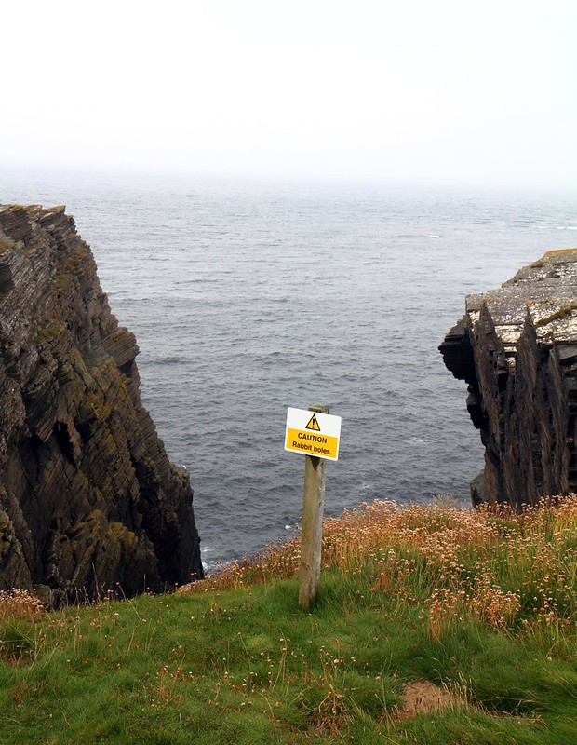
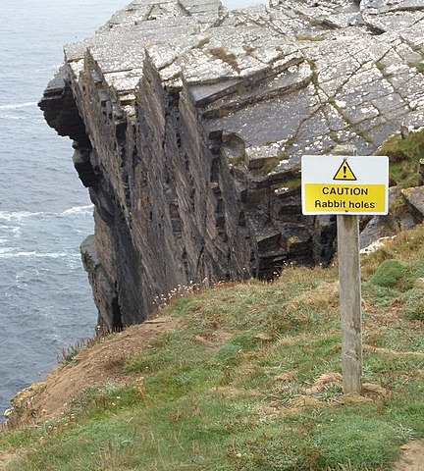
Need Help? Check out …
On Your Own…
Contact Me…
Research Guides
Subject → Other help guides → Open Educational Resources (OER)
Brenda Smith (Open Education Librarian)
brsmith@tru.ca
Notes:
Save yourself a lot of time and effort – don’t reinvent the wheel or go down rabbit holes, to use some metaphors.
If it’s already out there and created by someone else – go ahead and use it.
If it’s not perfect for your needs, modify it. On the other hand, don’t get stuck on searching forever for the perfect thing. Sometimes it’s quicker and easier to just create the exact thing that will meet your needs.
So, if you need help finding what you need, just ask. My job is to help you find content and to determine if it’s openly licensed and guidance navigating Creative Commons (CC) licences. I cannot provide legal advice or officially interpret CC tools, but I’m here as a resource.
With open, It’s a big shift in mindset to realize that you can borrow and reuse anything you find with an open licence as long as you attribute it.

Slide 63
Attributions
“Citations vs Attributions” by Amy Hofer for Open Oregon Educational Resources is licensed under CC BY 4.0. It was adapted from Citations vs. Attributions by Quill West, Open Education Project Manager, Pierce Community College, CC-BY 4.0.
“Copyright & Creative Commons Workshop” by Amanda Grey, Urooj Nizami, and Brenda Smith is licensed under CC BY 4.0 except where otherwise noted and is adapted from a copyright and Creative Commons presentation by Lindsay Tripp, Jamie Whitman, and Urooj Nizami.
“Creative Commons Certificate for Educators, Academic Librarians, and Open Culture” by Creative Commons is licensed under CC BY 4.0
“Creative Commons Workshop” by Camosun College is licensed under CC BY 4.0
“OER Faculty Workshop” by Matthew Bloom, Maricopa County Community College District / Maricopa Center for Learning and Instruction is licensed under CC BY-SA 4.0
“Open Access Overview” by Peter Suber is licensed under CC BY-3.0

Slide 64
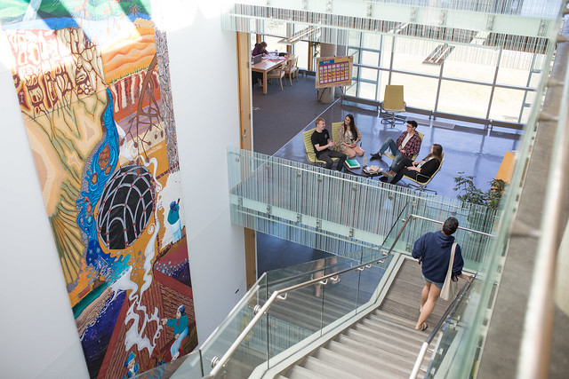
Questions? Evaluation: https://tru.libwizard.com/f/workshopevaluation

